Slide 1
CloudCore
Day 1 – Fundamentals

Slide 2







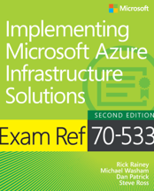
Dan Patrick is the Chief Infrastructure Architect for Solliance and General Manager of the DevOps practice.
A 15 year veteran at Microsoft. He has an extensive background in IT Infrastructure and Operations.
Dan has both architected and lead teams building and supporting some of the largest service providers in North America with as many 15,000 Windows Servers and 120 million endpoints.
Dan has worked with Azure IaaS solutions extensively since 2012. He has a passion for Virtualization with deep experience leveraging Hyper-V, VMware, and Citrix. He is also a Clustering specialist focusing on large host clusters and SQL Always On Availability Groups.
Recently Dan, authored the Networking, Azure Active Directory and Containers portion of the 70-533 Exam Reference for Microsoft Press.
Dan Patrick
Chief Infrastructure Architect
dan@solliance.net
@deltadan
314.537.1796

Slide 3

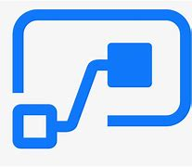
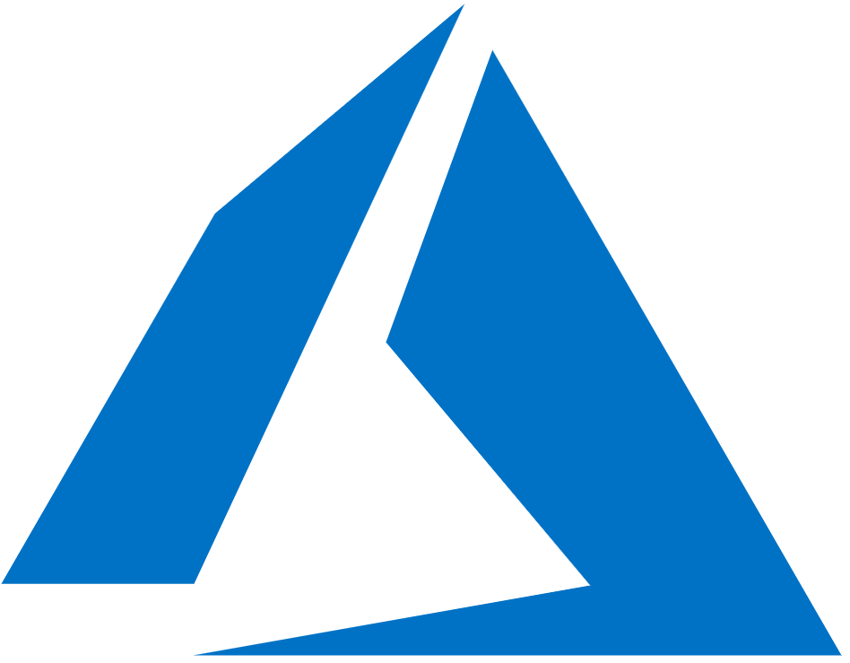

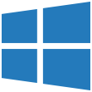
Cloud Platforms
The best cloud for your applications
+
Power Platform
Microsoft 365
Azure
Notes:
Need to better explain efficient in the remainder of the story and pay it off.
Showcase flexible in the remainder of the story more prominently

Slide 4
Cloud Concepts

Slide 5
Cloud Service Models
Traditional
on-premises
Infrastructure
(as a Service)
Platform
(as a Service)
Software
(as a Service)
Applications
Applications
Applications
Applications
You manage
Data
Data
Data
Data
Runtime
You manage
Runtime
Runtime
Runtime
Middleware
Middleware
Middleware
Middleware
You manage
O/S
O/S
O/S
Managed by vendor
O/S
Virtualization
Virtualization
Managed by vendor
Virtualization
Virtualization
Servers
Servers
Servers
Servers
Managed by vendor
Storage
Storage
Storage
Storage
Networking
Networking
Networking
Networking

Slide 6
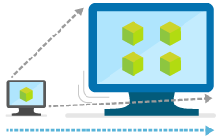
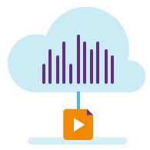
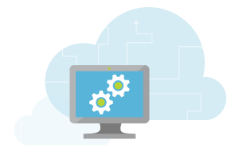
Azure Services
Web and mobile
Line of Business
Apps like SAP,
SharePoint
Microservices apps
Dev and test
Big data and analytics
Internet of Things
Backup, recovery, and archive
High performance computing
Digital media

Slide 7
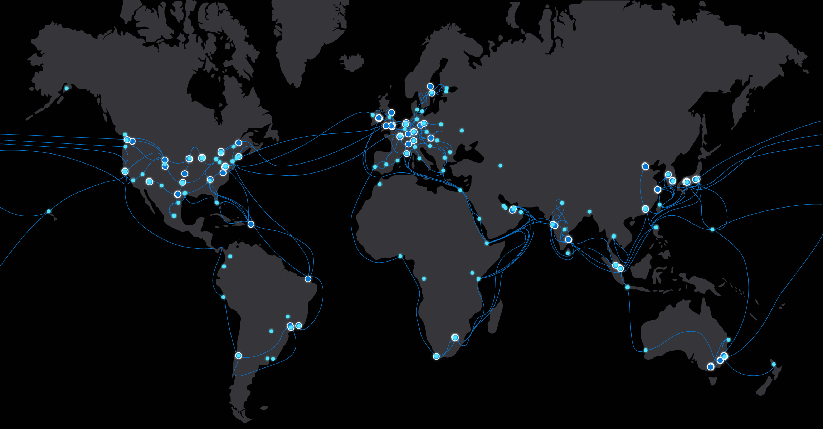
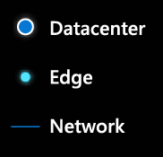
Microsoft global network
61
Azure regions
130K+
miles of fiber and subsea cables
160
edge sites
200+
ExpressRoute partners

Slide 8

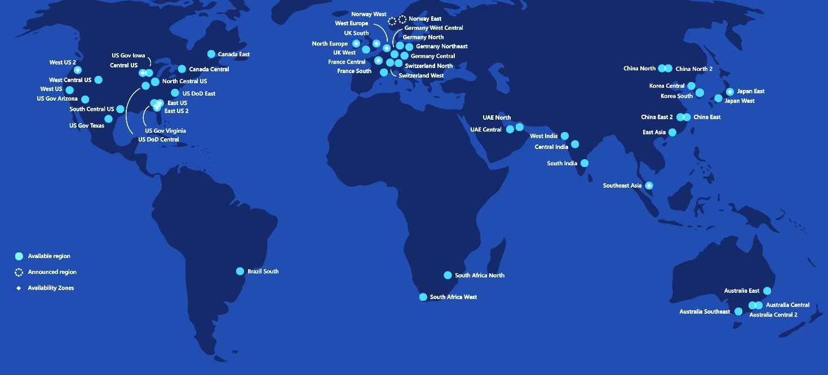
Azure Regions
60+
Azure regions
> 3x the number of AWS regions

Slide 9
Regions paired for geo-redundancy
Designed for high data availability, resiliency against regional disasters
Geo-replicated data still within national boundaries for 8 countries
> 100 miles
US West
US
East
Geo replication
Notes:
Additionally, data is asynchronously copied to another datacenter that’s at least 400 miles away.
So you can be sure that every piece of data that you store in the Azure Blob is available as well as protected against regional disasters (we call this geo-replication).
Geo replication is a unique feature, that differentiates us from competition.

Slide 10
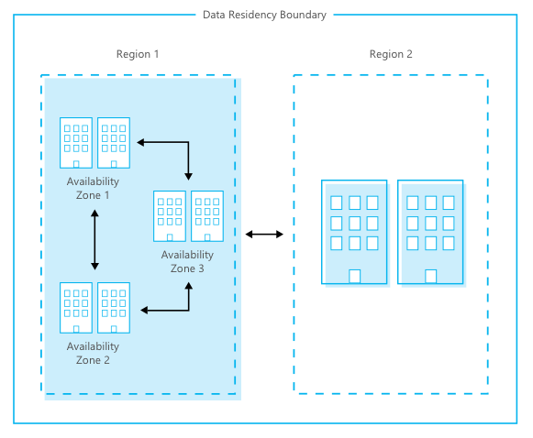
Availability Zones
Protect against datacenter-level failures
3 separate zones within each supported region
Independent power source, networking and cooling

Slide 11

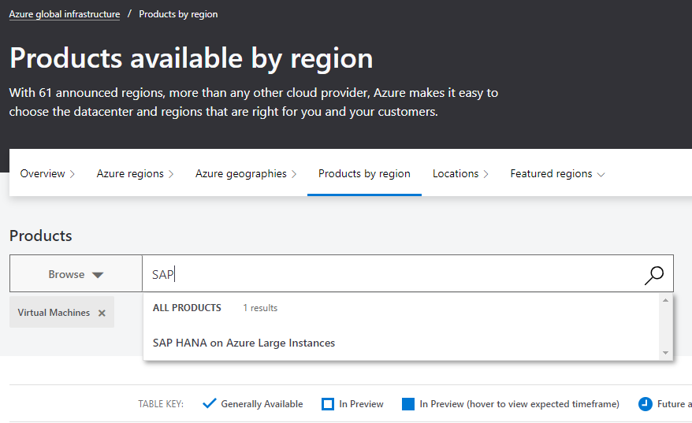
Azure Services by Region
Notes:
https://azure.microsoft.com/global-infrastructure/services/

Slide 12
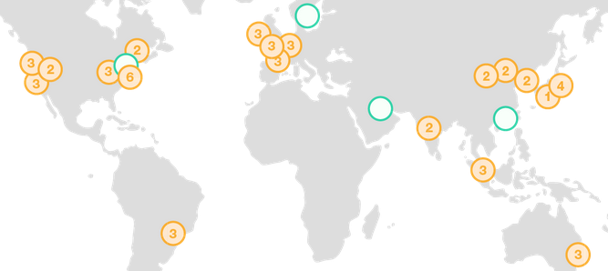
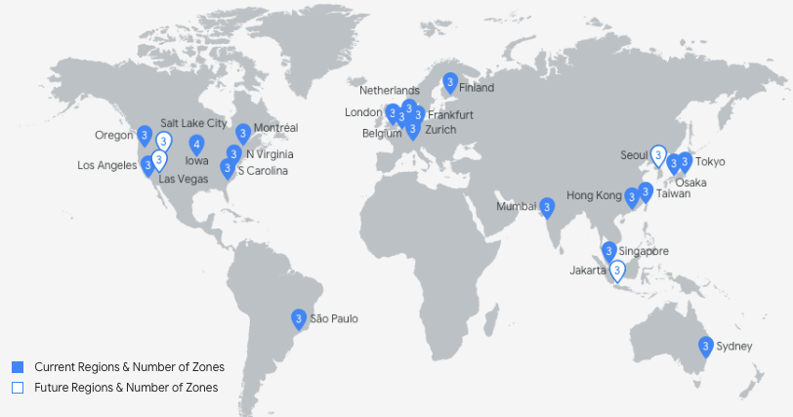

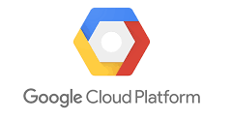
AWS & Google Regions
24
24
AWS regions
GCP regions
70+ Availability Zones
70+ Availability Zones
Notes:
REFERENCE:
https://aws.amazon.com/about-aws/global-infrastructure/regions_az/
https://cloud.google.com/about/locations/

Slide 13
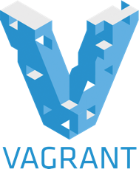





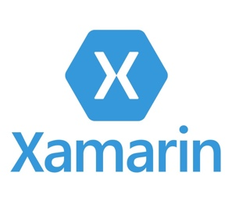
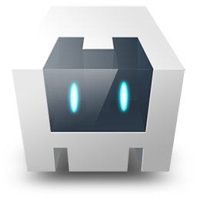
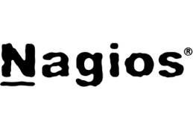

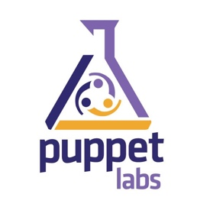

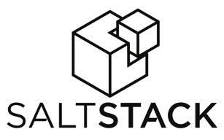
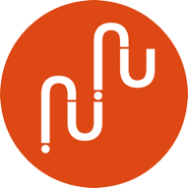

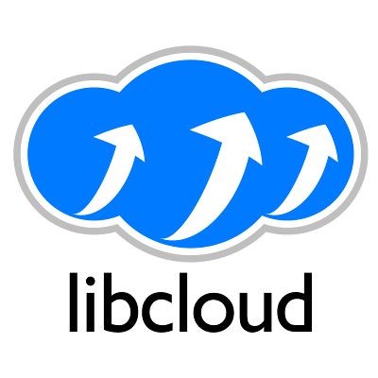


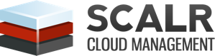
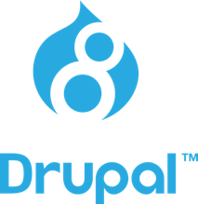

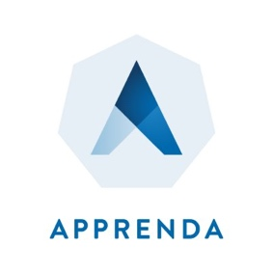
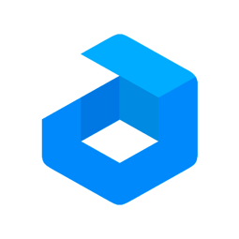

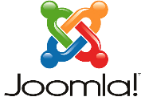

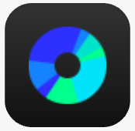









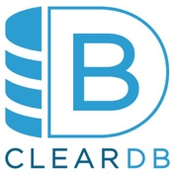
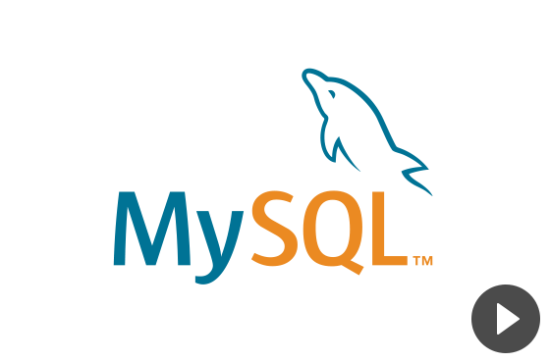

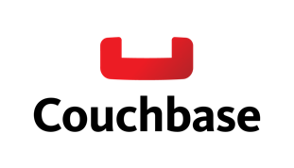






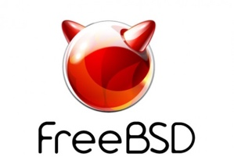



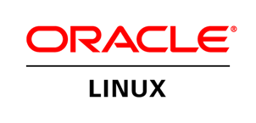
Open and Flexible
DevOps
Management
Applications
App frameworks
& tools
Databases &
middleware
Infrastructure

Slide 14
Consistent identity, apps, data & management
Azure Active Directory
Azure Management and Security
Azure
Data Services
Azure Services
Common Identity
Management & Security
Data Platform
Unified Development
Active
Directory
On-premises
Infrastructure
SQL Server
Azure Stack

Slide 15
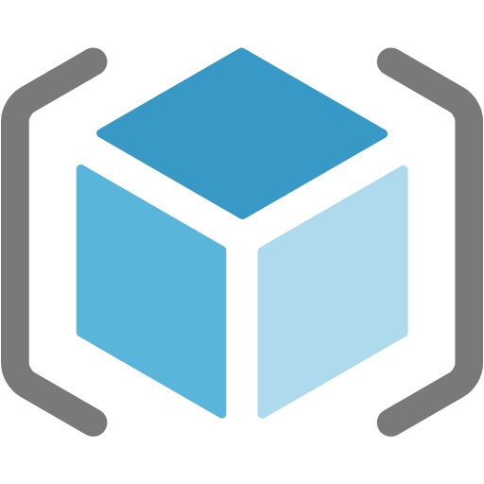
Azure Resource Manager
Enable application management within Azure
Resource groups are containers that can contain multiple IaaS + PaaS resources
Support lifecycle management with integrated Role Based Access Control (RBAC)
Templatize application deployment and configuration, supports DevOps

Slide 16
Organize
Resource Groups
Tag resources with meta-data, allows for detailed billing
One Click Delete resources, including across regions
RESOU
R
CE G
R
OUP

Slide 17
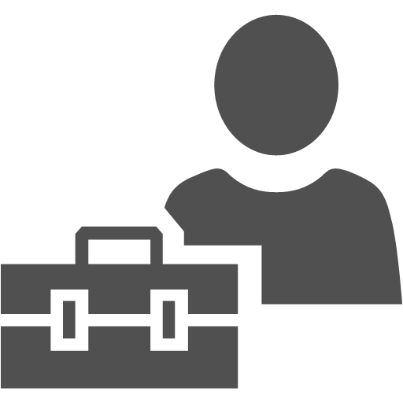

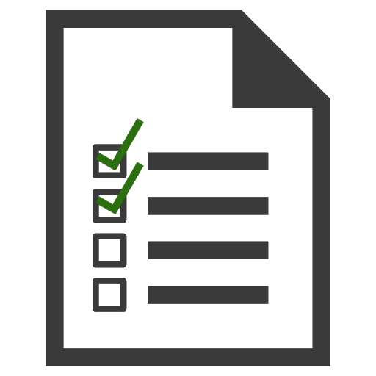
Control
Manage Permissions by defining Roles
Apply locks to critical resources, preventing accidental changes or deletions
Log & audit all user actions

Slide 18
Compute

Slide 19
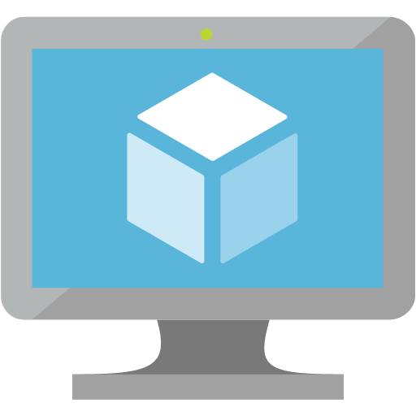
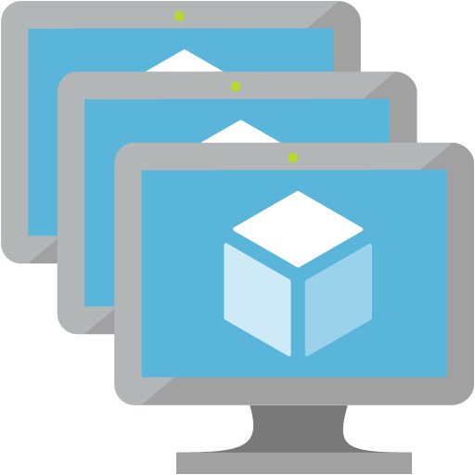
Virtual Machines & Scale Sets
Minimal learning curve for existing virtualization pros
Run most Windows or Linux-based workloads
Easiest target for migrating to the cloud
Flexible instance sizes – use the best fit for your workload
Advanced networking and storage capabilities
Virtual Machines
All of the power and flexibility of a Virtual Machine
Designed for high-end workloads
Automatically scale up (or down) to 1000 instances
Virtual Machine Scale Sets

Slide 20
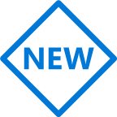

Compute Options for all types of apps
A
Av2
B
D
Dv2
Dv3
DC
F
Fv2
ENTRY LEVEL
BURSTABLE
GENERAL PURPOSE
COMPUTE OPTIMIZED
G
Ev3
M
L
NC
NV
NCv2
ND
H
MEMORY OPTIMIZED
STORAGE OPTIMIZED
GRAPHICS INTENSIVE
HIGH PERFORMANCE COMPUTING
HANA
PURPOSE-BUILT FOR
SAP HANA

Slide 21

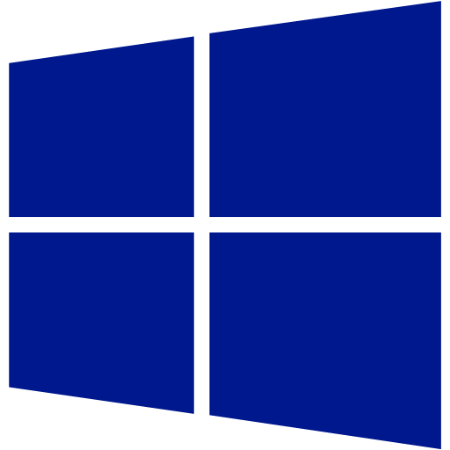
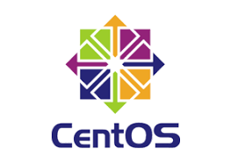

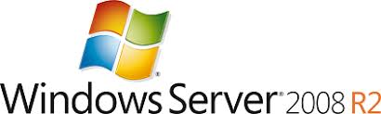

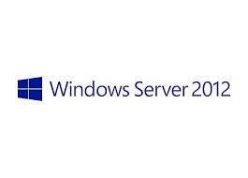
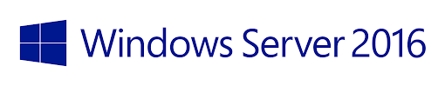
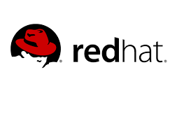

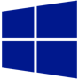

Supported Configurations
Windows Server
Windows Server 2019

Slide 22
Availability Options
Industry-only
High availability SLA
Disaster recovery
VM SLA
VM SLA
VM SLA
Regions 60+
99.9%
99.95%
99.99%
Region 1
Region 2
Single VM
Availability sets
Availability zones
Site Recovery & Region pairs
Protection with Premium Storage
Protection against failures within datacenters
Protection from entire datacenter failures
Protection from disaster with data residency compliance
AZs available across US, Europe and Asia… more regions coming soon

Slide 23
Azure Reserved Instances
Reserve virtual machines in advance
Select 1- or 3-year terms with significant benefits
Significant cost savings up to 82%* over pay-as-you-go models
Budget predictability and prioritized compute capacity
Flexibility to modify reservations and simplicity of purchase
*When combined with Azure Hybrid Benefit

Slide 24
Azure Hybrid Benefit for Windows Server
Pay for just base compute costs by using your existing Windows Server licenses with Software Assurance
Apply licenses to Azure for use with Azure Reserved VM Instances
Maximize value from current investments
Available for both pay-as-you-go and Azure Reserved VM Instances

Slide 25


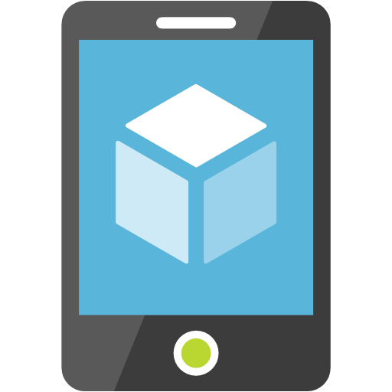
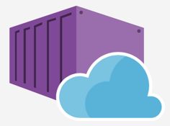

Azure App Service
Web Apps
Web apps that scale with your business
Mobile Apps
Build mobile apps for any device
Web App for Containers
Serverless event based development accelerator
API Apps
Easily build and consume APIs in the cloud

Slide 26






Azure App Service
Windows
Multi-Language Support
Linux & Containers

Slide 27

Serverless
Allows Developers to focus on Apps, not Infrastructure
Not just hardware “servers”, but software servers are also managed for you
Focus on business logic, not solving technical problems not core to business
Lower effort to get started makes it easier to experiment (bots, etc.)

Slide 28
Azure Container Instances
Azure Kubernetes Service (AKS)
Azure container technologies
Azure Service Fabric
Azure App Service

Slide 29
Storage

Slide 30

Azure Storage
Blobs
Highly scalable, REST based cloud object store
Block Blobs: Sequential file I/O
Cool Tier Available
Page Blobs: Random-write pattern data
Append Blobs
Disks
Persistent disks for Azure IaaS VMs
Premium Storage Disks option: SSD based, high IOPS, low latency
Files
Fully Managed File Shares in the Cloud
SMB and REST access
“Lift and shift” legacy apps
Synch with on-premises (New!)
Tables
Massive auto-scaling NoSQL store
Dynamic scaling based on load
Scale to PBs of table data
Fast key/value lookups
Queues
Reliable queues at scale for cloud services
Decouple and scale components
Message visibility timeout and update message to protect against unreliable dequeuers
Built on a unified Distributed Storage System
Durability, Encryption at Rest, Strongly Consistent Replication, Fault Tolerance, Auto Load-Balancing

Slide 31
VM Storage Options
Now GA
Preview (NEW)
Standard HDD
Standard SSD
Premium SSD
Ultra SSD
Single disk max value
Low-cost storage
Consistent performance
High performance
Sub-millisecond latency
SIZE
32TiB
32TiB
32TiB
64TiB
IOPS
2,000
2,000
20,000
80,000 – 160,000
BANDWIDTH
500 MBps
500 MBps
750 MBps
2,000 MBps

Slide 32
Networking

Slide 33
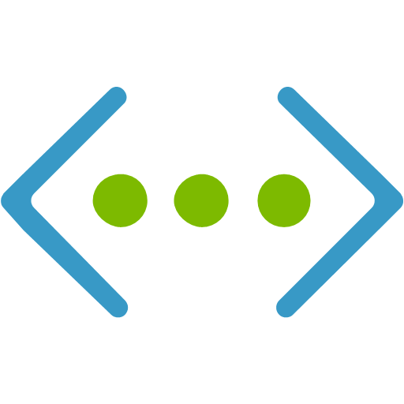








Azure Networking Services
Virtual Network
ExpressRoute
Load Balancer
Firewall
Application Gateway with WAF
Front Door
Traffic Manager
Content Delivery Network
3rd Party Solutions from Marketplace

Slide 34





Hybrid Cloud?
Running workloads in the public cloud and on-premises with a secure network connection between
Secure connectivity
with VPN
On-Premises Datacenter
Cloud Provider

Slide 35
Seattle
Dublin
Amsterdam2
Montreal
Newport, Wales
Amsterdam
Chicago
Quebec City
London
Silicon Valley2
Toronto
Paris
Silicon Valley
Denver
New York City
London2
Las Vegas
Marseille
Seoul
Tokyo
Dallas
Washington DC
Los Angeles
Washington DC2
Busan
Osaka
Atlanta
San Antonio
Miami
Dubai
Dubai2
Taipei
Hong Kong
ExpressRoute locations
Mumbai
Chennai
Kuala Lumpur
Singapore
Singapore2
Johannesburg
Sao Paulo
Cape Town
Canberra
Perth
Canberra2
Sydney
Auckland
Melbourne

Slide 36
Migration & BCDR

Slide 37

Azure Migration Options
Migrate
Modernize
Move VMs to Azure IaaS and make almost no changes to the applications & databases
Innovate cloud native technologies, containers, microservices & serverless
Timeline Driven IT oriented migration, Data center moves
Lack of Support & Compliance
Business priority driven
App oriented migration triggers, Innovation and DevOps based
Triggers
Fastest way to the cloud, Extended Support & Compliance, Agility, Leverage your investment in Windows
Reborn in the Cloud apps, can be managed with DevOps and extended with new capabilities such as AI, Machine Learning and Cloud scale
Benefits

Slide 38



Cloud Journey
Migrate
Lift & Shift applications to Azure and Leverage SQL Managed Instances
Modernize
With Azure Web Applications and Azure SQL Database along with Front Door
Microservices
Build Cloud native services using Windows Containers and Azure Services
Notes:
Moving your Windows Servers to the cloud is best described as a journey.
This will include “Migrating” applications to the cloud using Azure VMs and SQL Managed Instances for databases.
<click>
Next, “Modernizing” to leverage Azure PaaS services such as Web Applciatoins, Azure SQL and Front Door which including and autoscaling
<click>
And then finally, building “Microservices” for your applications and leveraging born in the cloud services like CosmosDB and Windows Contianers.

Slide 39



VM & SQL Migration Tools
Build an inventory, and then migrate servers & data
Azure Migrate
Azure Site Recovery
Data Migration Service
Discover on-premises VMs and app dependencies
Mitigate VM migration issues with built-in guidance
Adjust and optimize cloud resources based on utilization
Free One Way migrations to Azure
Minimal downtime during migrations
Zero risk backout procedure if the migration is unsuccessful
Use a simple, self-guided migration process
Get comprehensive assessments detailing pre-migration steps
Migrate at scale from multiple sources to your target database
Notes:
Migrating your Windows and SQL based applications is simple using the build in Azure tools: Azure Migrate, Azure Site Recovery and the Data Migration Service.
Azure Migrate:
This tool can be used to discover your existing applications which can be deployed to physical servers, VMware or Hyper-V. Detemrine which servers are used for each application and then plan for the size and costs for each VM. Azure Migrate will make recommendations to ensure that you have the correct VM size and setup prior to the migration.
Azure Site Recovery:
This tool is used to move the Servers to Azure for free. Using a one way failover, servers will become Azure VMs. You can test the migrations and backout of the migration if for some reason you have issues during the cutover.
Data Migration Service:
Moving data is the risky part of any migration. The Data Migration Service allows you to pre-seed your data and have it ready in Azure for the cut over. You can migrate many databases at once which allows for a seamless migration of many application’s databases.

Slide 40










Azure Data Box Family
Offline Data Transfer
Online Data Transfer
Data Box
Capacity: 100 TB
Weight: ~50 lbs
Secure, ruggedized appliance
GA September 2018
Data Box enables bulk migration to Azure when network isn’t an option.
Data Box Disk
Capacity: 8TB ea.; 40TB/order
Secure, ruggedized USB drives orderable in packs of 5 (up to 40TB).
Currently in Preview
Perfect for projects that require a smaller form factor, e.g., autonomous vehicles.
Data Box Heavy
Capacity: 1 PB
Weight 500+ lbs
Secure, ruggedized appliance
Preview September 2018
Same service as Data Box, but targeted to petabyte-sized datasets.
Data Box Gateway
Virtual device provisioned in your hypervisor
Supports storage gateway, SMB, NFS, Azure blob, files
Preview: September 2018
Virtual network transfer appliance (VM), runs on your choice of hardware.
Data Box Edge
Local Cache Capacity: ~12 TB
Includes Data Box Gateway and Azure IoT Edge.
Preview: September 2018
Data Box Edge manages uploads to Azure and can pre-process data prior to upload.
Network Data Transfer
Edge Compute
Order
Send
Fill
Return
Upload
Cloud to Edge
Edge to Cloud
Pre-processing
ML Inferencing

Slide 41


Disaster Recovery to/for the Cloud
VMware
Hyper-V
Physical
Failover from your data center
Failover between regions in Azure

Slide 42
Azure Backup
Decrease reliance on tape backup to save money and increase agility
Azure Backup integrated with SCDPM protects enterprise workloads including SharePoint, Exchange, SQL Server, and Hyper-V VMs,
Lowers the management costs of backing up remote/branch offices
Reduce the dependence on offsite tape backup to accelerate recovery time

Slide 43
Security, Identity & Compliance

Slide 44

Secure your digital estate like you would your home
Identity & access management
Threat
protection
Information protection
Security management
Identity & access management
Threat
protection
Information protection
Security management

Slide 45
Compliance is a shared responsibility
Customer
Microsoft
Data governance & rights management
Client endpoints
Account access & management
Identity & directory infrastructure
Application
Network controls
Virtual Operating System
Physical hosts
Physical network
Physical datacenter
On-prem
IaaS
PaaS
SaaS
Always retained by customer
Varies by service type
Transfers to Microsoft

Slide 46





Security Control Planes in Azure
Resource
Configuration
Networking
Identity
Governance
Tools
Azure AD
Conditional Access
Service Principal
Managed Identity
Roles
Subscriptions
Management Groups
Policies
Blueprints
Security Center
Sentinel
Key Vault
Azure Threat Protection
RBAC
Storage
SQL
ACR
AKS
Firewall
FrontDoor
WAF
NSGs
Service Endpoints

Slide 47

Identity is the Control Plane of most concern
Authentication
Authorization
Something you know
Apps & resources
Something you have
Data
Something you are
Access level

Slide 48


Azure AD Identity Protection + Azure AD conditional access Maximize Security. Maximize Productivity.
Conditions
Controls
10TB
Allow access
Users
Session Risk
Machine learning
3
Limit access
Devices
On-premises apps
Require MFA
Real time Evaluation
Engine
Location
Force password reset
******
Policies
Effective policy
Web apps
Apps
Deny access

Slide 49

Protect against threats across the hybrid cloud
Detect and block advanced malware and threats for servers
Detect threats across IaaS and PaaS services using advanced analytics
Reduce exposure to brute force attacks
Azure Security Center
Protect data services against malicious attacks

Slide 50


Azure Sentinel
Cloud Scale Security Event Information Management (SEIM) for On-Premises & All Clouds
Collect Data at Cloud Scale
Detect previously uncovered threats an minimize false positivizes
Investigate threats with AI tapping into decades of cybersecurity work at Microsoft
Respond to incidents rapidly with automation
Notes:
https://docs.microsoft.com/en-us/azure/sentinel/connect-windows-security-events

Slide 51

Begin a Compliance Journey in the Microsoft Trust Center
Microsoft Trust Center is your resource for learning how Microsoft implements and support security, privacy, compliance, transparency in its cloud products and services. The Trust Center is an important part of the Microsoft Trusted Cloud initiative and provides support and resources for the legal and compliance community.
In-depth information about security, privacy, and compliance offerings, policies, features, and practices across Microsoft cloud products.
Recommended resources, a curated list of the most applicable and widely-used resources for each topic.
Information specific to key organizational roles, including business managers, tenant admins or data security teams, risk assessment and privacy officers, and legal compliance teams.
Direct guidance and support, including options for contacting Microsoft in the Contact Trust Center section of the overview page.
http://www.microsoft.com/TrustCenter

Slide 52
Whiteboard Design Session
Networking

Slide 53
It’s a team effort - https://bit.ly/37ENRLj
Join meeting room on your calendar
Design a solution and prepare to present the solution to the target customer audience in a 15-minute presentation.
Review business needs (15 minutes) | Review the customer scenario, needs and objections
Design & Prepare (75 minutes) | Design a solution for as many of the stated requirements as time allows. Prepare for a 15-minute presentation to the customer Respond to questions outlined in your guide and list the answers. Show the solution in a presentation including diagrams if required.
Present (15 minutes) | Deliver 15-minute presentation to the customer

